Slide 1
Programming Android
Getting Started

Slide 2
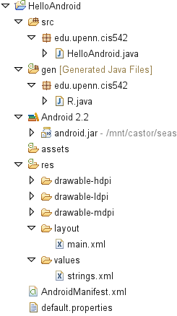
Source
code
Auto-generated
code
String
constants
UI
layout
Configuration

Slide 3
Life Cycle
The steps that an application goes through from starting to finishing
Slightly different than normal Java life cycle due to :
the difference in the way Android application are defined
the limited resources of the Android hardware platform

Slide 4
Android Applications
Applications are defined to Android via the android manifest file, located in the root of the Android studio project definition (AndroidManifest.xml)
Double clicking on the AndroidManifest.xml file in the Eclipse project will open the Manifest editor.
The manifest editor is the normal way of creating and modifying the manifest file (defining the app to the system)

Slide 5
Android Applications
An Android application is a collection of activities, an activity correlates to a screen or form that is presented to the user.
The HelloAndroid is a simple one screen app that is essentially the same as a Java app run in a terminal/command window. Its AndroidManisest.xml file reflects this :

Slide 6
AndroidManifest.xml
<?xml version="1.0" encoding="utf-8"?>
<manifest xmlns:android="http://schemas.android.com/apk/res/android"
package="com.example.helloandroid"
android:versionCode="1"
android:versionName="1.0">
<application android:icon="@drawable/icon" android:label="@string/app_name">
<activity android:name=".HelloAndroid"
android:label="@string/app_name">
<intent-filter>
<action android:name="android.intent.action.MAIN" />
<category android:name="android.intent.category.LAUNCHER" />
</intent-filter>
</activity>
</application>
</manifest>

Slide 7
<manifest>
The manifest tag has the following attributes:
xmlns ; the name of the namespace (android) and where the DTD for the xml parser is located
package ; the name of the java package for this application (must have at least two levels)
android:version ; the version code for this version of the app
android:versionName ; The version name (for publishing)

Slide 8
<activity>
child tag of <manifest>
need one <activity> tag for each activity of the application
attributes:
android:name; the name of the activity, this will be used as the name of the Java file and the resulting class
android:label; a string that we will be able to programatically retrieve the activity name at run time.

Slide 9
<intent-filter>
Child tag of <activity>
First, what’s an intent? In OO-speak an intent is a message sent from one program to another (message dispatcher) to tell the system what to do next. Typically an intent consists of two parts; an action and the data that that action is supposed to use to do it.
When you select an icon on the main page the intent is to run the app associated with that icon
The tag is used to construct an android.content.IntentFilter object to handle a particular android.content.Intent

Slide 10
<action>
child of <intent-filter>
the action we want done:
Predefined actions of the intent class of android.content ; see the api at:
http://developer.android.com/reference/android/content/Intent.html

Slide 11
<category>
child of <intent-filter>
additional attributes that can be supplied
LAUNCHER – indicates that it should apper in the launcher as a top level application
see the api documentation for more on intent resolution.

Slide 12
Life Cycle
Each application runs in its own process.
Each activity of an app is run in the apps process
Processes are started and stopped as needed to run an apps components.
Processes may be killed to reclaim needed resources.
Killed apps may be restored to their last state when requested by the user

Slide 13
Management
Most management of the life cycle is done automatically by the system via the activity stack.
The activity class has the following method callbacks to help you manage the app:
onCreate()
onStart()
onResume()
onPause()
onStop()
onRestart()
onDestroy()

Slide 14
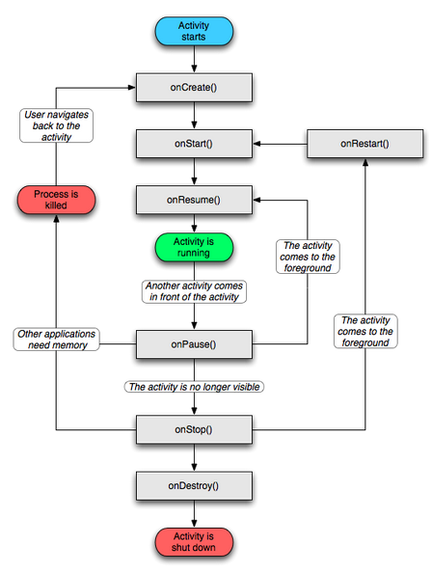
The Activity life-cycle.
There are 6 stages in the Android Activity life cycle.
These stages allow you to perform tasks in their correct time of the workflow.

Slide 15
HelloAndroid.java
1 public class HelloAndroid extends Activity {
2 /** Called when the activity is first created. */
3 @Override
4 public void onCreate(Bundle savedInstanceState)
5 {
6 super.onCreate(savedInstanceState);
7 setContentView(R.layout.main);
8 }
9 }

Slide 16
main.xml
1 <?xml version="1.0" encoding="utf-8"?>
2 <LinearLayout
3 xmlns:android="http://schemas.android.com/apk/res/android"
4 android:orientation="vertical"
5 android:layout_width="fill_parent"
6 android:layout_height="fill_parent"
7 >
8 <TextView
9 android:layout_width="fill_parent"
10 android:layout_height="wrap_content"
11 android:text="@string/hello "
12 />
13 </LinearLayout>

Slide 17
strings.xml
1 <?xml version="1.0" encoding="utf-8"?>
2 <resources>
3 <string name="hello">Hello World, HelloAndroid!
4 </string>
5 <string name="app_name">Hello, Android</string>
6 </resources>

Slide 18
AndroidManifest.xml
1 <?xml version="1.0" encoding="utf-8"?>
2 <manifest
3 xmlns:android="http://schemas.android.com/apk/res/android"
4 package="edu.upenn.cis542"
5 android:versionCode="1"
6 android:versionName="1.0">
7 <application android:icon="@drawable/icon"
8 android:label="@string/app_name">
9 <activity android:name=".HelloAndroid"
10 android:label="@string/app_name">
11 <intent-filter>
12 <action
13 android:name="android.intent.action.MAIN" />
14 <category
15 android:name="android.intent.category.LAUNCHER"/>
16 </intent-filter>
17 </activity>
18 </application>
19 </manifest>

Slide 19
The Activity – Layout.
Consists of xml.
Describe the static layout of a screen.
A few types available:
LinearLayout – children are lined up automatically.
RelativeLayout - children order needs to be defined.
ListView – children are items of a list.
Etc.

Slide 20
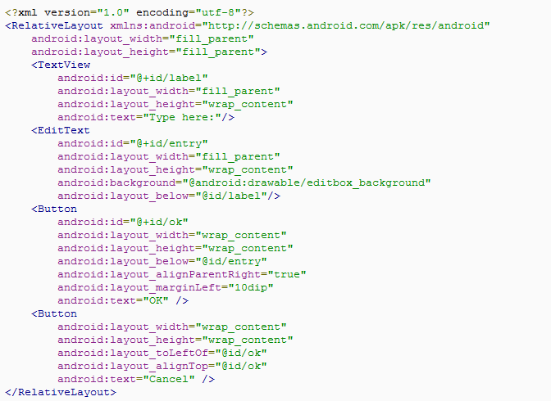
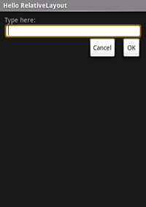
The Activity – Layout example.

Slide 21

.The Service
An application component that can perform long-running operations in the background and does not provide a user interface.
The service has two forms:
A "started“ service is called by an app component and runs in the background even if the application that called it was closed.
A “bound” service is bound by an app component and is used as a client-server bridge, this sort of service is terminated when the application that is bound to it is closed.

Slide 22
Starting a service.
From the activity perform:
The startService() method returns immediately.
If the service is not already running, the android system calls onCreate(), then calls onStartCommand() else it only calls the onStartCommand() method.

Slide 23
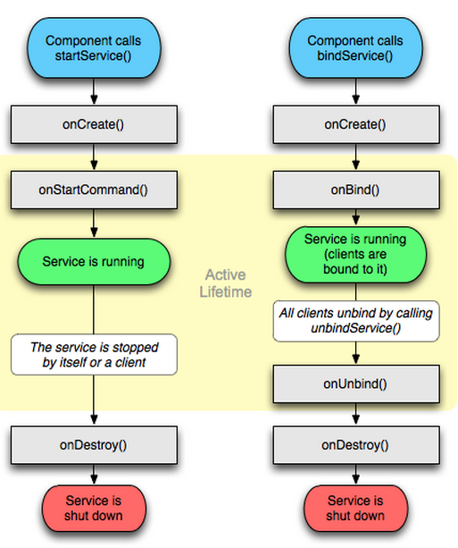
The service life cycle.
The same principle as in the activity life cycle applies here only the stages are different.
As you can see the bound and started services have a similar cycle with a twist:
The bound service is only “alive” while the binding application is “alive”.

